Slide 1
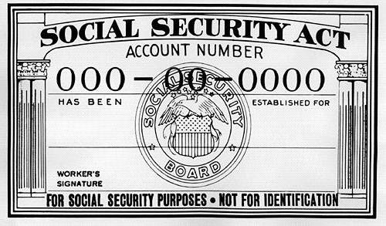
Social Security & RR Retirement Tier 1
Pub 17, Chapter 11
Pub 4012 Tab D
(Federal 1040-line 20)
Notes:
1

Slide 2
Tax On Social Security & Railroad Retirement Benefits Tier 1
Social Security (SS) and Railroad Retirement Benefits Tier 1 have same tax treatment
May be nontaxable or partially taxable, depending on total income from other sources
Up to 85% of benefits may be taxable
May be taxable if one-half of SS plus all other income (including tax-exempt interest) is greater than:
$32,000 MFJ
$25,000 single, HOH or qualified widow
$25,000 MFS & lived apart all year
$0 MFS & lived together any part of year
TaxSlayer calculates how much of SS is taxable on Federal return
Social Security and Railroad Retirement Benefits Tier 1 are not taxable in NJ
Note: There is no line item for them on NJ 1040
Notes:
2

Slide 3
Social Security/Railroad Retirement Benefits Tier 1 on NJ 1040
Neither Social Security nor Railroad Retirement Tier 1 is taxable for NJ so they do not flow through to NJ return
Medicare premiums entered on Social Security screen will flow through to medical expenses on NJ 1040 line 30 (if medical expenses exceed 2% of NJ gross income on line 28)
Therefore, NJ taxable income can change when you enter Social Security or Railroad Retirement Tier 1. Even though there is no new income on NJ return, the medical expense deduction can increase
Notes:
3

